Slide 1




E-COMMERCE
WEBSITE
FRONT-END
PROJECT
MADE BY- ABHIMANYU KASHYAP
ROLL NO- 2110990042
GROUP NO- 5
TOTAL NO OF PAGES IN PROJECT- 20
SUBMITTED TO- Mr. LAVISH ARORA

Slide 2

Overview
Introduction
Why choose us
Goals
Challenges
Project Overview
Future Scope

Slide 3

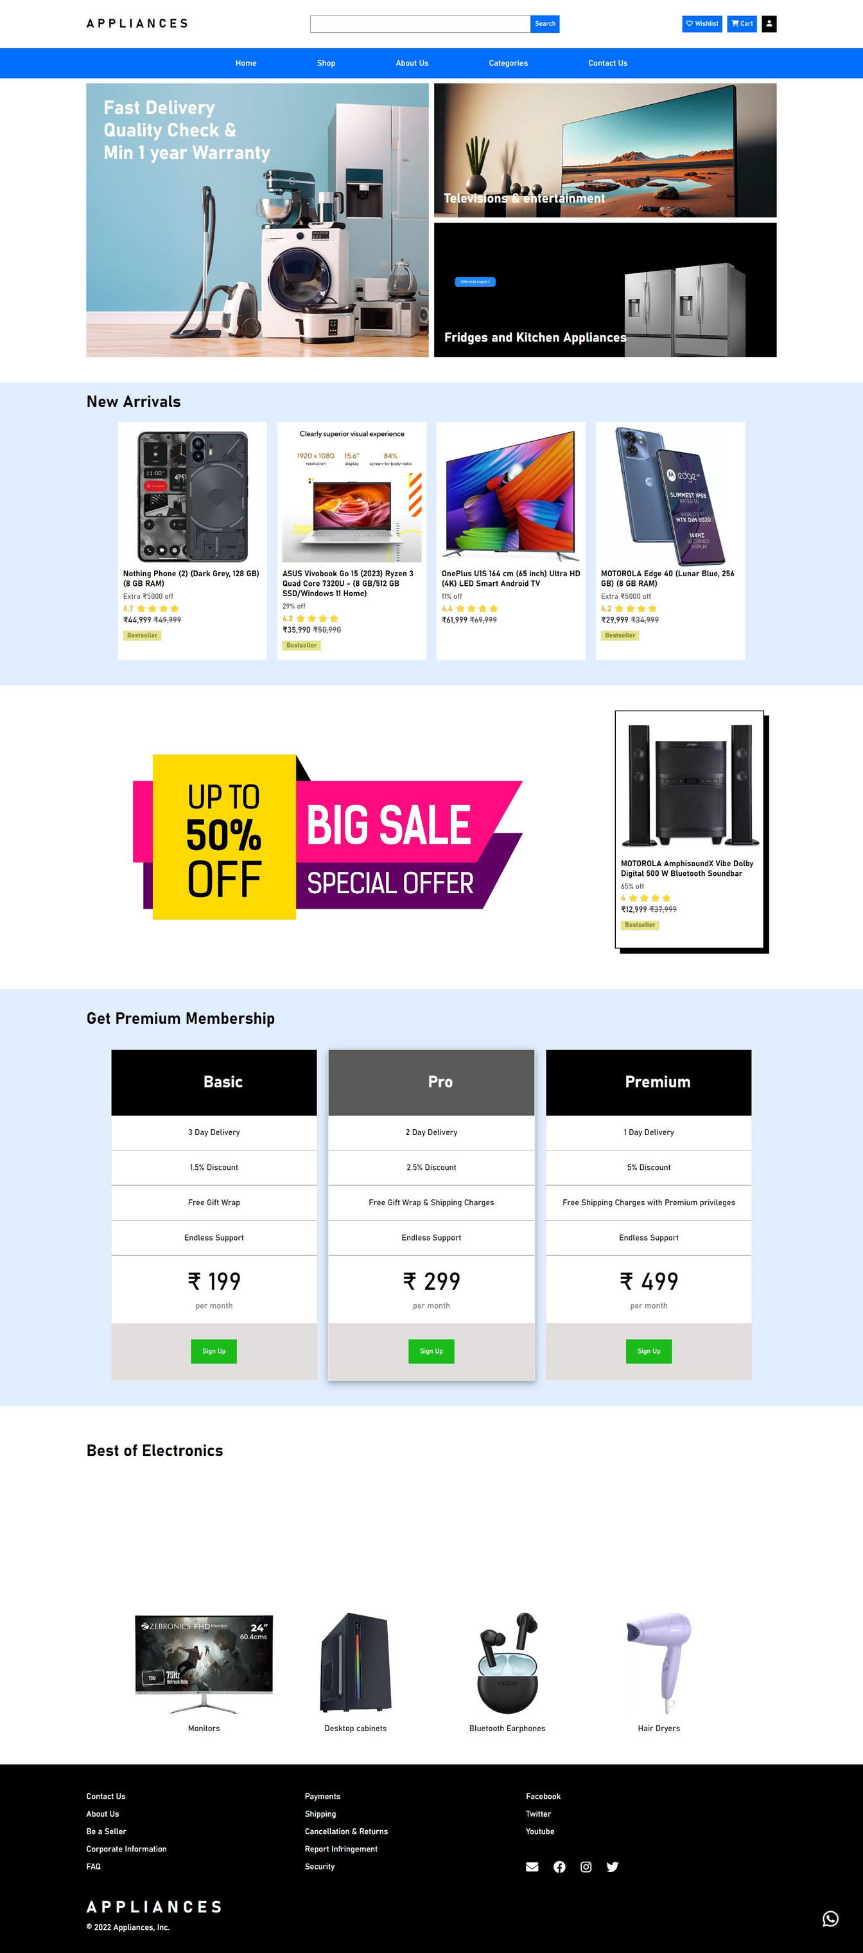
Introduction
Welcome to our college front-end project, a showcase of our skills and knowledge in web development. This project was created using JavaScript, HTML, and CSS to demonstrate our ability to design a user-friendly and visually appealing website. Our primary focus was on delivering an exceptional user experience while applying best practices in front-end development.
This project allowed us to apply what we've learned and gain practical experience in the field. It reflects our dedication to web development and showcases our problem-solving and skills. In the following sections, we'll delve into the project's features and technologies used to bring it to life. Thank you for joining us on this journey through our project.

Slide 4


Why Choose this Name?
Our e-commerce site primarily focuses on selling a wide range of appliances, such as kitchen appliances, home appliances, or electronic gadgets, the name "Appliances" is highly relevant. It immediately communicates the core focus of your business to potential customers.
Simplicity
Credibility
"Appliances" is a simple and easy-to-remember name. It avoids any complexity or ambiguity, which can make it easier for customers to find and remember your website.
A straightforward and descriptive name like "Appliances" can convey a sense of professionalism and trustworthiness to potential customers. It suggests that you specialize in the products you offer.

Slide 5






Goals
01
02
03
04
·User-Friendly Interface: Create an intuitive and user-friendly interface to ensure customers can easily navigate through products, categories, and features.
·Responsive Design: Develop a responsive design that works seamlessly across various devices and screen sizes to accommodate mobile, tablet, and desktop users.
·Product Catalogue: Implement a comprehensive product catalogue with categories, filters, and sorting options for customers to quickly find the appliances they need.
User Authentication: Implement user registration and login functionality for a personalized shopping experience, including saved addresses and order history.

Slide 6






Challenges
·Data Management: Managing a vast amount of product data, including images, descriptions, and reviews, can be complex and resource-intensive.
·Payment Gateway Integration: Integrating and testing payment gateways can be challenging due to security and regulatory requirements.
·Responsive Design: Ensuring a seamless user experience on various devices and screen sizes can be technically challenging.
·Performance Optimization: Achieving fast load times, especially when handling large images and data, can be challenging.

Slide 7

Project
Overview
In the project that has been shown below, I have tried to create a website using HTML, CSS and JavaScript with proper payment gateway i.e., it has some constraints which won’t allow user to put false or empty input in the data base. User can’t use online payment if he hasn’t selected the online payment as the payment mode. Further more basic functionalities like scroll animations and carousels have been added which further adds up to user experience. Colour and aesthetics of site has been kept simple and minimal to further increase user appeal. Demo page and Different category pages are made for easier browsing to find your favourite in a nick of a time.

Slide 8
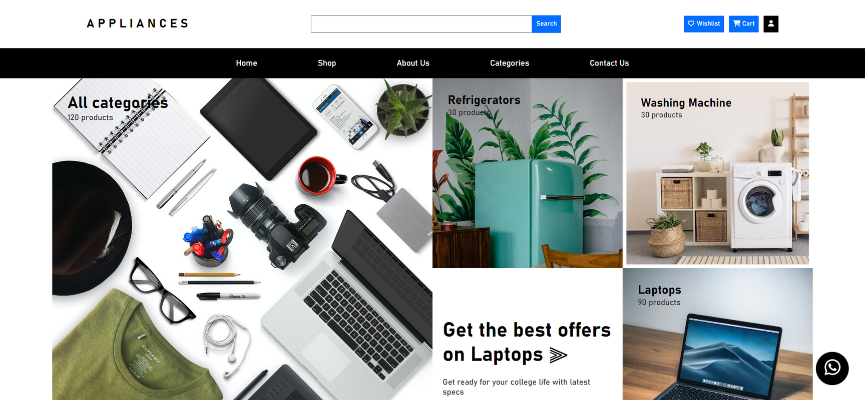
Category Page

Slide 9
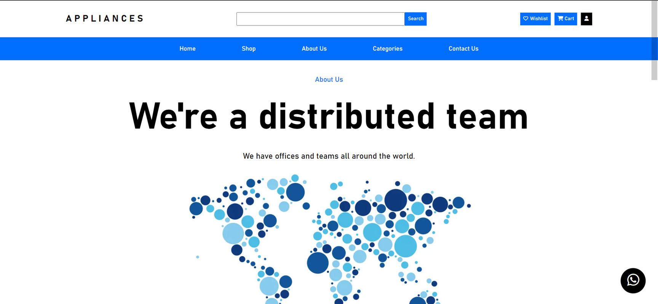
About Us Page

Slide 10
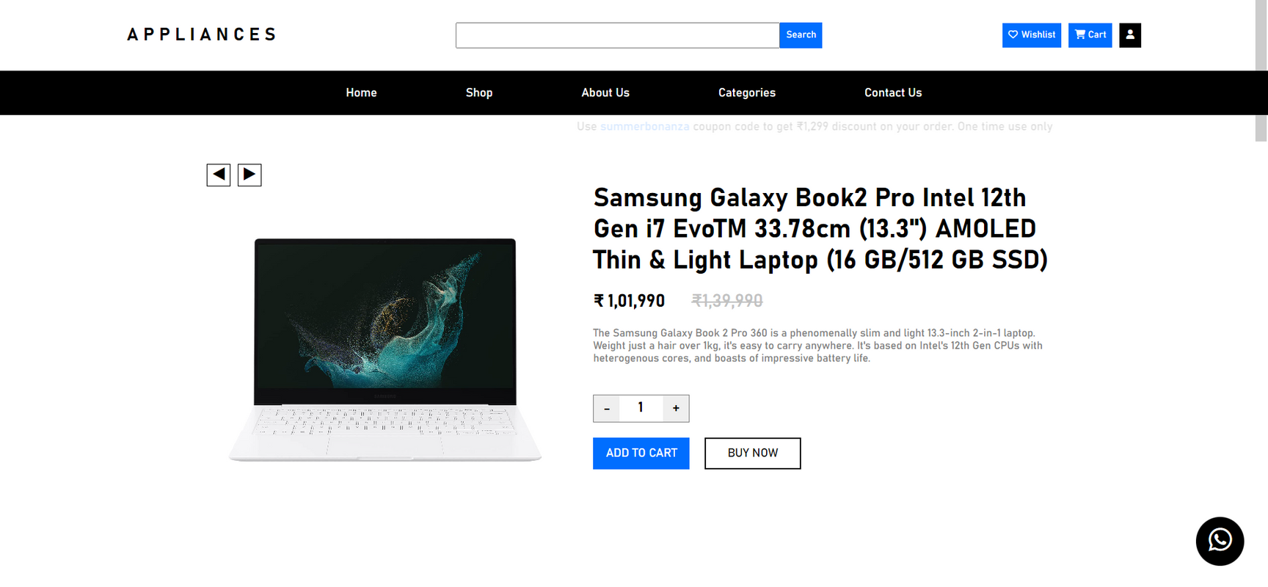
Single Product Page

Slide 11




Future-Scope
Mobile App Development
Consider developing a dedicated mobile application for "APPLIANCES" to provide a seamless and optimized shopping experience for mobile users.
Personalization and AI
Implement advanced personalization techniques and artificial intelligence to provide customers with product recommendations, personalized content, and a tailored shopping experience.
Voice Commerce
Enable voice search and voice-assisted shopping for hands-free browsing and ordering through voice-activated devices.

Slide 12



THANK YOU
For watching this presentation
8699029899
kashyapabhimanyu639@gmail.com
Chitkara University, Rajpura

